Slide 1
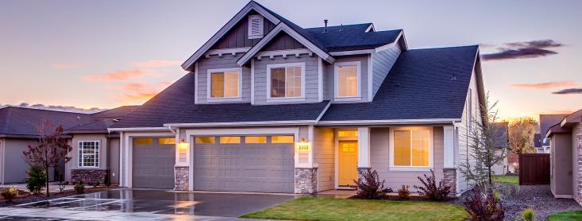
Iowa Residential Field Study Kickoff Meeting
Image: Chicago Architecture Center
Oran Pape Public Safety Building, Des Moines, IA
October 26, 2023

Slide 2




Midwest Energy Efficiency Alliance
The Midwest Energy Efficiency Alliance (MEEA) is a collaborative network, promoting energy efficiency
to optimize energy generation, reduce consumption,
create jobs and decrease carbon emissions in all
Midwest communities.
MEEA is a non-profit membership organization
with 160+ members, including:
Energy service
companies & contractors
State & local
governments
Academic &
Research institutions
Electric &
gas utilities

Slide 3

The Field Study Team
Outreach
TEG Team
MEEA Team
Kyle Huston
Lee Vannoy
Cindy Stevens
Chris Burgess
Michelle Thorsell
John Gossman
Bill McAnally

Slide 4




What is a Field Study?
A research study about typical single-family construction practices
Anonymous on-site observations of common energy related key measures
Results only published on statewide basis
No data, photos or identifying information will be shared with anyone outside the study, including authorities having jurisdiction

Slide 5

What is a Field Study?
Collection of data typically takes less than an hour
Will not interfere with ongoing operations
Goal is to better understand how energy code requirements are being implemented in the field
  Basis for developing additional resources

Slide 6
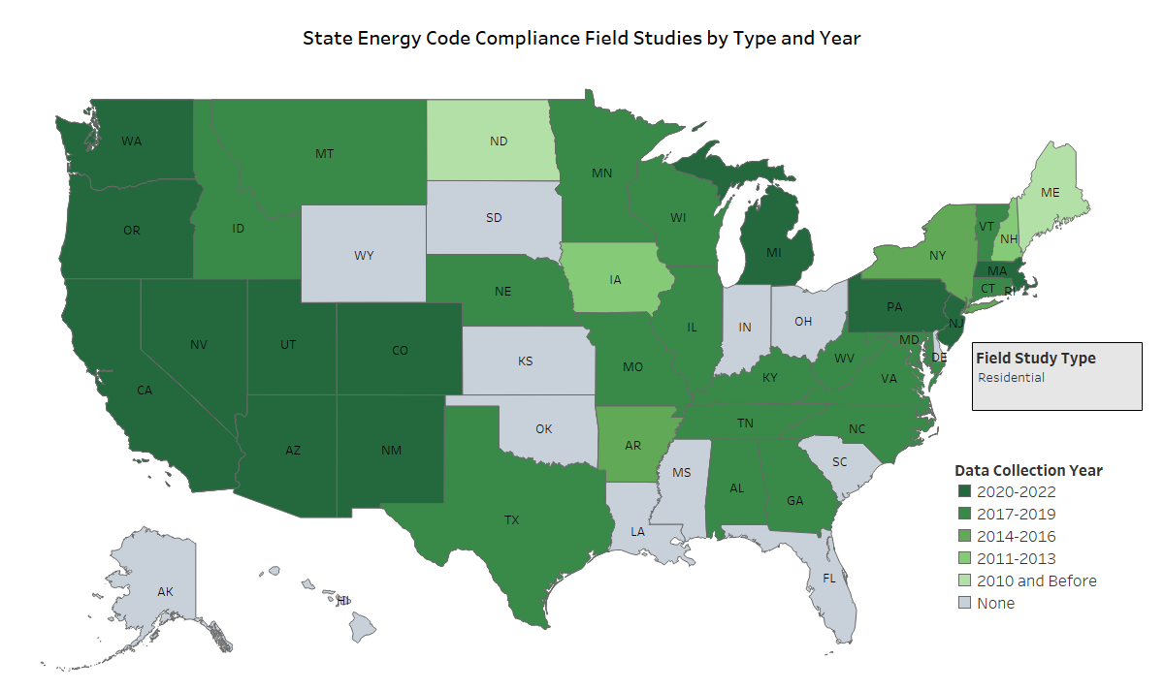
Who Has Done a Field Study?
Field Studies are Not New

Slide 7
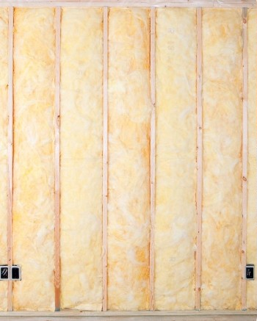
How Does a Field Study Get Done?
Study is done on a county basis
  Any new, never-occupied home in a selected county can participate
Data will be collected at Pre-Drywall phase and at Final
63 data sets are required for the study
  1 pre-drywall + 1 final = 1 data set
Image: All Florida Insulation

Slide 8
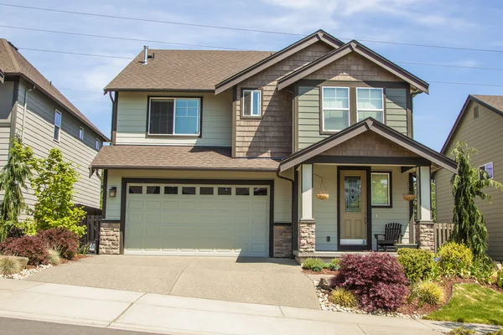
How Does a Field Study Get Done?
Both components of a data set have to be from the same county
A given home can only be visited once
  Therefore, the study data collected cannot determine individual home compliance.

Slide 9
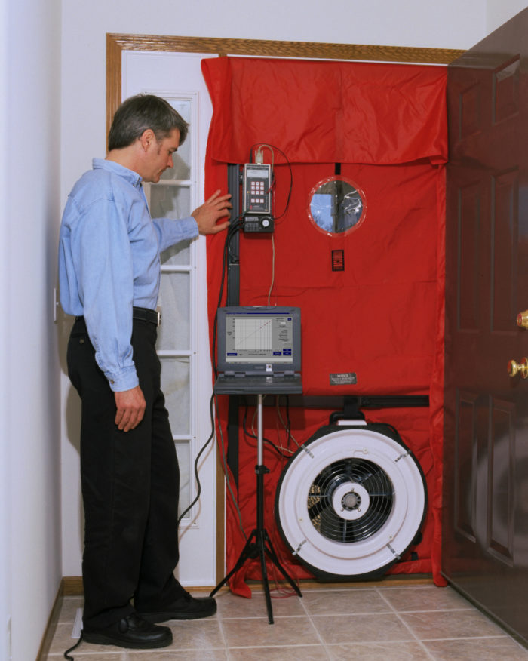
How Does a Field Study Get Done?
A blower door test and duct tightness test are required for each data set
  Can share these results with builder upon request
Trained data collectors will visit construction site to collect data for the study

Slide 10

How Does a Field Study Get Done?
Data collection at pre-drywall typically takes about half an hour
Data collection at final, including testing, typically takes about an hour
Data collectors provide their own equipment and will clean up after themselves
  Not that there is much to clean up

Slide 11
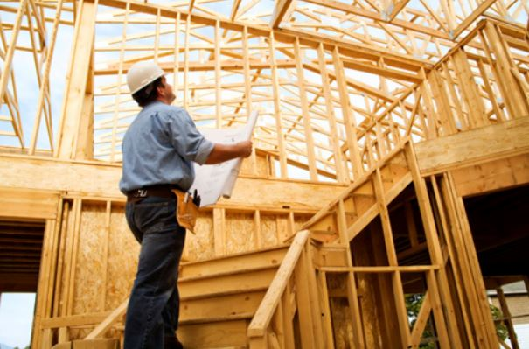
Data Collection Points – Key Items
Envelope Tightness
Window U-Factor
Wall Insulation
Ceiling Insulation
Foundation Insulation
High Efficacy Lighting
Duct Leakage
Electrical Panel Size

Slide 12
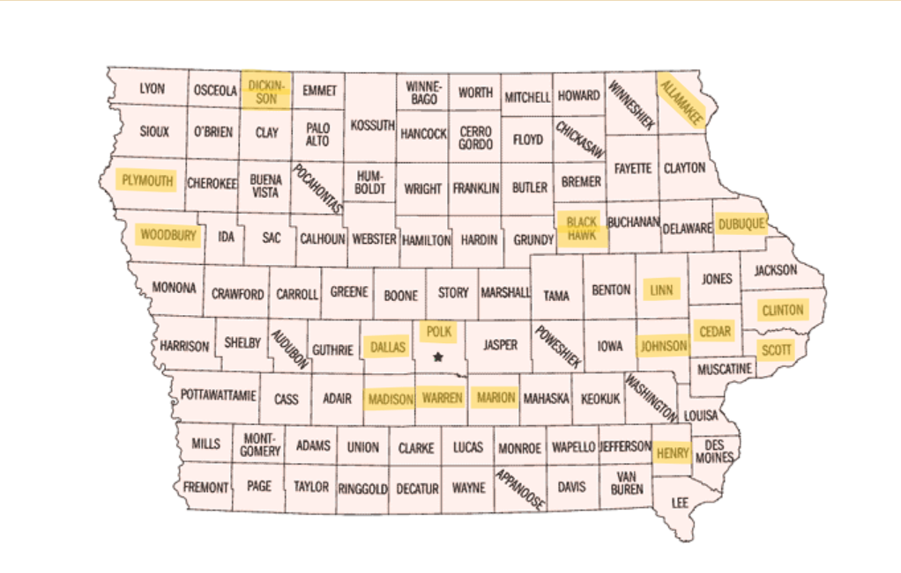
Counties Included
Polk County 5A | 22
Dallas County 5A | 7
Linn County 5A | 7
Scott County 5A | 5
Dubuque County 5A | 4
Warren County 5A | 3
Black Hawk County 6A | 3
Johnson County 5A | 2
Henry County 5A | 2
Dickinson County 6A | 1
Woodbury County 5A | 1
Marion County 5A | 1
Madison County 5A | 1
Allamakee County 6A | 1
Plymouth County 6A | 1
Clinton County 5A | 1
Cedar County 5A | 1

Slide 13
Next Steps
Bill McAnally
Initial Outreach to Jurisdiction and Builders
TEG
Site Visit Scheduling, Data Collection
MEEA
Anonymize Data, QA/QC, Coordinate Analysis

Slide 14
What Can You Do To Help
Allow for data to be collected if Bill reaches out
Proactively reach out to Bill McAnally if you know people or projects that would benefit the field study
Help spread the word about the field study
A successful and accurate field study will benefit the entire state of Iowa

Slide 15
Questions?
Bill McAnally
mcanally.bill@gmail.com
Kyle Huston
khuston@theenergygroup.biz
John Gossman
jgossman@mwalliance.org

